Slide 1

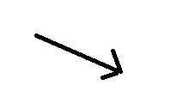

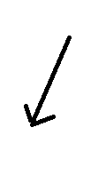
↓
Line[102-196]
1
2
2
3
actionPerformed(ActionEvent arg0)
[ try{input = Double.parseDouble(textField_input.getText());]
↓
4
4
5
6
if(Condition1)
textField_ans.setText(Double.toString(result));
[Null]
7
↓

Slide 2
result = con.EUROtoTAKA(input);
8
9
10
[Null]
if (Condition)
11
↓
↓
result = con.RUPEEtoTAKA(input);
12
13
14
[Null]
15
result = con.TAKAtoEURO(input);

Slide 3
16
17
18
[Null]
if (Condition2)
19
↓
result = con.TAKAtoRUPEE(input);
20
if (Condition3)
21
22
[Null]
23
↓

Slide 4
//For same input**
24
25
26
[Null]
if (Condition1)
27
↓
28
29
30
[Null]
if (Condition2)
31
↓

Slide 5
32
33
34
if (Condition3)
[Null]
35
↓
36
37
38
[Null]
if (Condition4)
39
↓

Slide 6
// for partial input
40
if (Condition1)
41
42
[Null]
43
↓
44
45
46
if (Condition2)
[Null]
47
↓

Slide 7
48
if (Condition3)
49
50
[Null]
51
↓
52
if (Condition4)
53
54
[Null]
55
↓

Slide 8
56
if (Condition5)
57
5
[Null]
58
↓
59
60
62
if (Condition6)
[Null]
63
↓

Slide 9
64
if (Condition7)
65
66
[Null]
67
↓
68
if (Condition8)
69
70
[Null]
71
↓

Slide 10
72
73
74
[Null]
if (Condition9)
75
↓
76
77
78
if (Condition10)
[Null]
79
↓

Slide 11
↓
80
81
catch(Exception e)
↓
82
End

